Slide 1
DCHC’s Performance Measure (PM) Tool
Yanping Zhang
2023 Fall NCMUG Meeting, Nov. 15th, 2023

Slide 2
Introduction
Generating Performance Measures (PMs), Summary Report and Evaluating Scenarios
Supporting Metro Transportation Plan (MTP), Congestion Management Process (CMP), other programs and projects
Requiring Inputs & Outputs of Triangle Region Model (TRM) and/or Other Data Resources as inputs to the PM Tool
GISDK Script

Slide 3
Geographical Levels
County, MPO & Region
Corridor & Transit Line
Link, Node, Stop & TAZ
Performance Metrics are generated for three geographical levels

Slide 4
Summary Report – Part 1
Part 1 includes,
VMT
VHT
Average Speeds
Person Trip Length

Slide 5
Summary Report – Part 2
Part 2 includes,
Commercial Vehicle (CV) Trip Length
Truck Trip Length
%VMT Experiencing Congestion (V/C ration>1)

Slide 6
Summary Report – Part 3
Part 3 includes,
Mode Share by trip purpose and time of day
CV and Truck Trips
Population & Employment
Transportation Supply, highway lane miles

Slide 7
Summary Report – Part 4
Part 4 includes,
Transit Ridership (unlinked Trips) by Transit Agency
Population & Employment
Supply Data, Transit Service Miles
Ridership of key transit routes

Slide 8
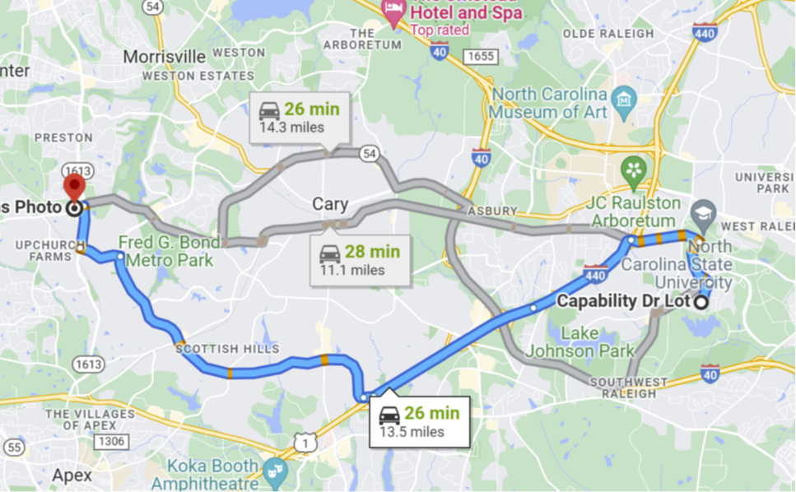
Vehicle Miles/Hours Traveled (VMT/VHT)
Calculation Method 1 - Summing up VMTs/VHTs of all links. Mostly used for Region, MPO, & County.
Calculation Method 2 – Multiplying Trips by average time/distance. For VMT, however, paths with same travel time may have different travel distances (see the picture for reference). This method is mostly for a small area and Person Miles Traveled (PMT)

Slide 9
Average Travel Time Calculation
For Inter-MPO/Inter-County Trips, trip Production (P) end determines which MPO/County it belongs to.
Calculation employes the following data items,
  Production-Attraction (P-A) Trip Matrices by
  trip purposes and Time of Day (TOD)
  P-A/A-P Travel Time matrices by TOD
  P-A Time of Day factor Tables

Slide 10
Equity Measures
Equity Measures by Mode
Example for Auto mode
Average Travel Time of Production-Attraction Trips
TAZ/Community of Concern (CoC) includes,
Local Income CoC
Minority CoC
ZeroCar CoC. (Measures in the Transit Measure Table)

Slide 11
2045 MTP Alternative Analysis

Slide 12
2050 MTP Alternative Analysis

Slide 13
Non-Motorized and Bus Trips of TAZs

Slide 14
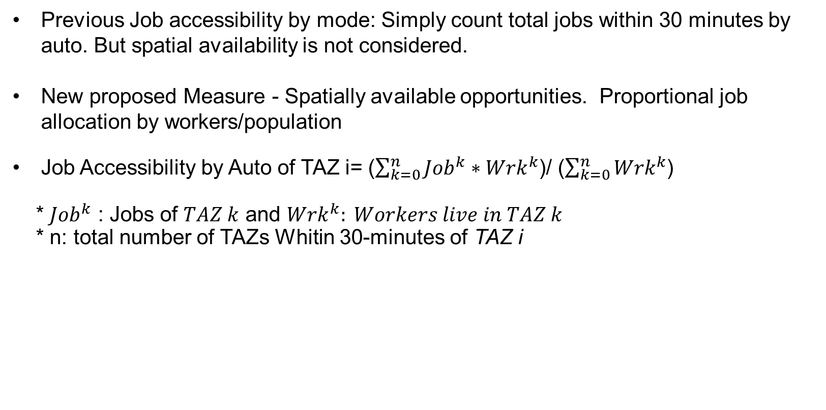
New Measure - Job Accessibility By Mode
Previous Job accessibility by mode: Simply count total jobs within 30 minutes by auto. But spatial availability is not considered.
New proposed Measure - Spatially available opportunities. Proportional job allocation by workers/population
Job Accessibility by Auto of TAZ i= ($\sum_{k=0}^{n}{{Job}^{k}{∗Wrk}^{k}}$)/ ($\sum_{k=0}^{n}{{Wrk}^{k}}$)
* ${Job}^{k}$ : Jobs of $TAZ k$ and ${Wrk}^{k}: Workers live in TAZ k$
* n: total number of TAZs Whitin 30-minutes of TAZ i

Slide 15
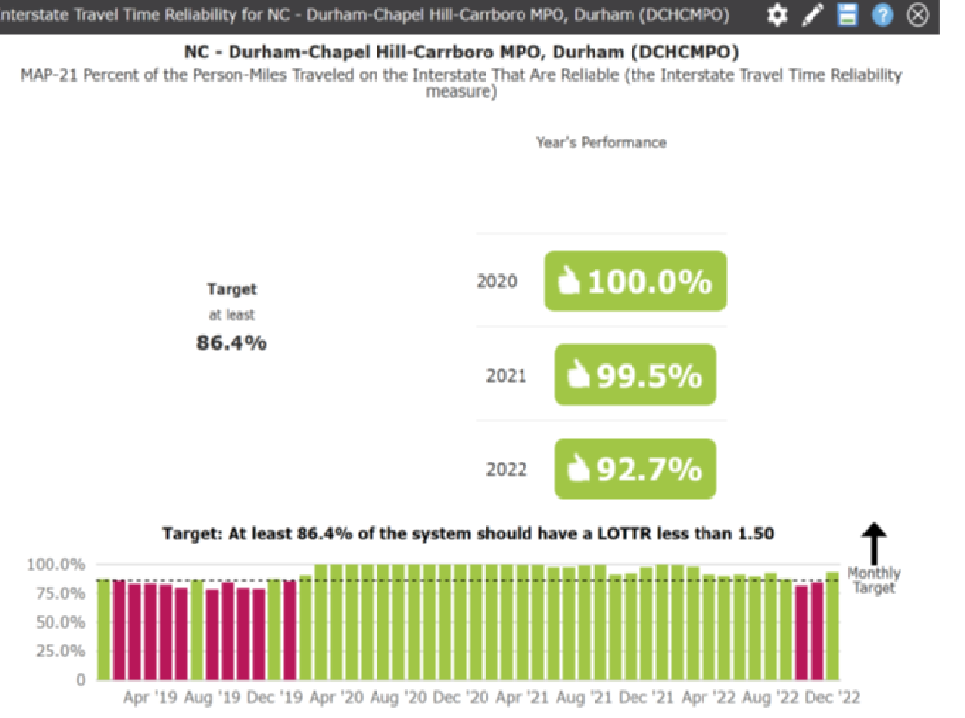
New Measure 2 – Travel Time Reliability
MAP-21 Performance Measures
Travel Time Reliability (TTR) by Interstate
and Non-Interstate National Highway
Estimate TTR and Level Of TTR (LOTTR) based on the TRM output and Base year INRIX travel speed information.

Slide 16
Thank You

